Slide 1
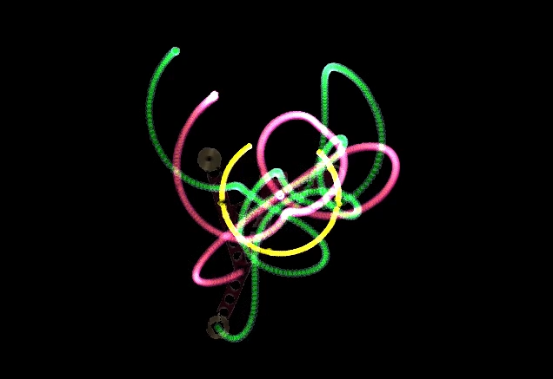
Quantifying Chaos
Angle and mass determinants on the chaotic motion of a triple pendulum.
Murray Jones · Yunki Yau · Riley Jones · Riley Fitzgerald · Adrian Wong
Notes:
Murray

Slide 2
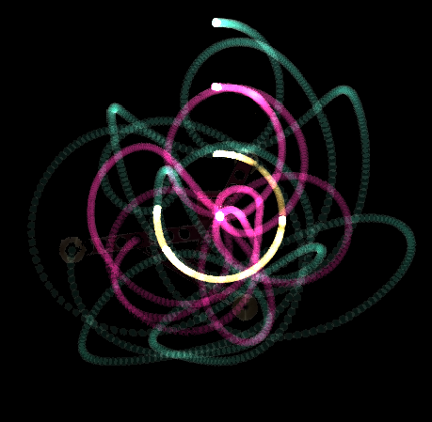
Chaos
“Chaos is when the present determines the future, but the approximate present does not approximately determine the future.”
- Edward Lorenz
Notes:
Murray

Slide 3
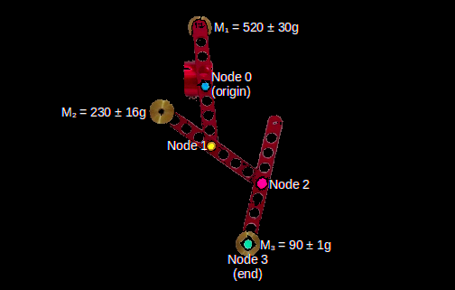
Aim & Hypothesis
To quantify the chaos of a triple pendulum over time, and relate this to the system’s initial conditions.
Angle to vertical (θ)
End node mass (M3)
Chaos ∝ System Energy
Initial Gravitational Potential Energy
Notes:
Murray

Slide 4
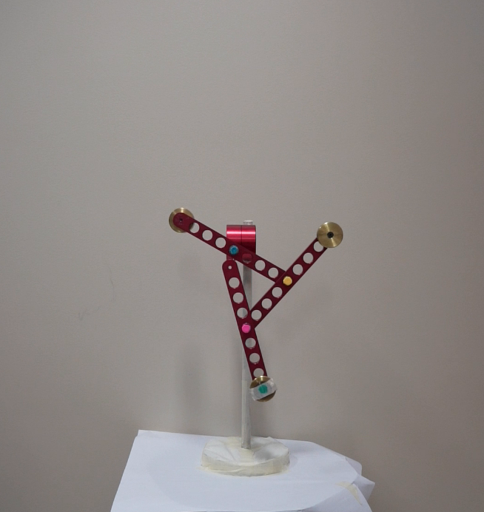
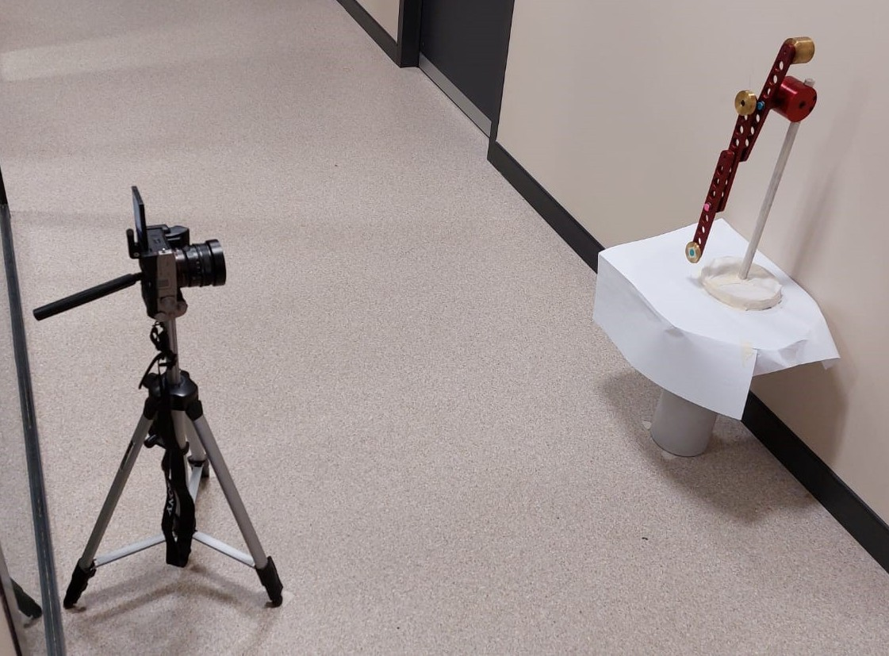
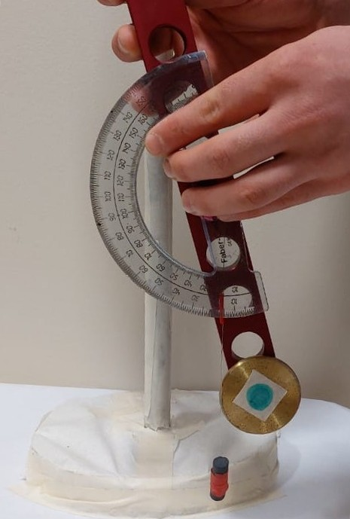
Collecting the Data
③
Three trials for each set of initial conditions.
USYD SoP Triple Pendulum.
1.2m
②
①
Sony A7C Full-Frame Camera, using a 24mm f2.8 lens at aperture f5.6.
Footage recorded at 1080p, 120 FPS.
Masking tape was used to cover reflective surfaces of the pendulum.
θ
An angle measurement device was developed for this experiment to set the initial release angle.
Notes:
Speaker: Yunki
We captured the motion of the triple pendulum using a Sony A7C Full-Frame mirrorless camera with a 24mm F2.8 prime lens. The way we set this was to place the pendulum in the hallway on a small bench that was approximately 45.4cm in height and placed the camera about 1.2m away from the pendulum. We ensured that the camera lens and the stationary node of the pendulum were in a horizontal plane (at approximately 90cm from the ground) to minimize parallax errors, and we levelled the camera using the native levelling tools within the camera.
We used masking tape to cover any reflective surfaces that could potentially interfere with the motion tracking program we were going to use, and we used coloured markers to identify each node of the pendulum with a unique colour, as you can see here.
We recorded the motion of the pendulum at various initial angles ranging from 0 to 180 degrees from the vertical, at approximately 15 degree increments. We recorded three trials for each angle for approximately 15 seconds. To quantify the angle that we released the pendulum at, we made a novel angle measurement device which consisted of a protractor with a string secured to the origin, and a 10gm weight tied to the end of the string to act as a plumb bob. We manually lined up all the arms to be parallel and eyeballed the angle using the protractor and string as the indicator.
We had one group member, Murray, setting the initial angle for all trials to minimize inter-experimentalist error.
The final video data was captured at 120fps at 1080p and saved as 50mbps mp4 files.
Other variables we captured video data for was different masses secured to the end node, and propagation of the last arm only, at the different angles. The results of these analyses haven’t been included in this presentation.

Slide 5
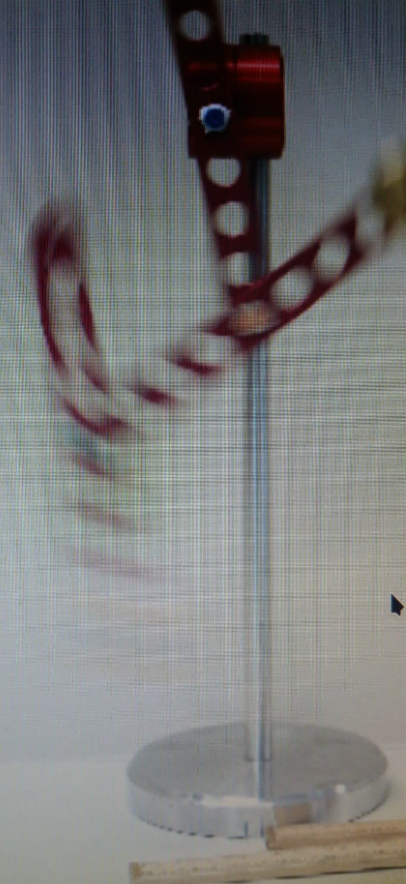
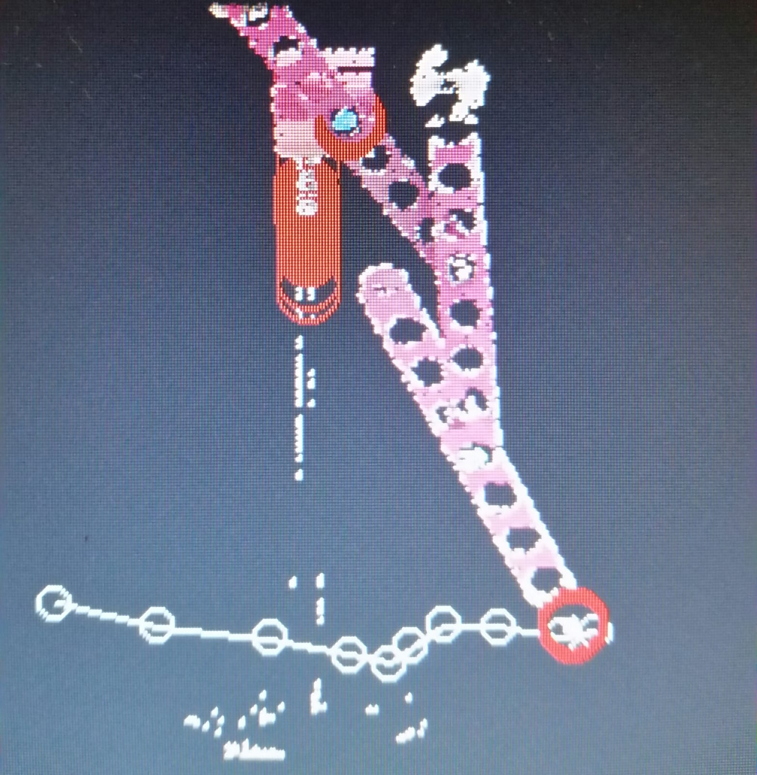
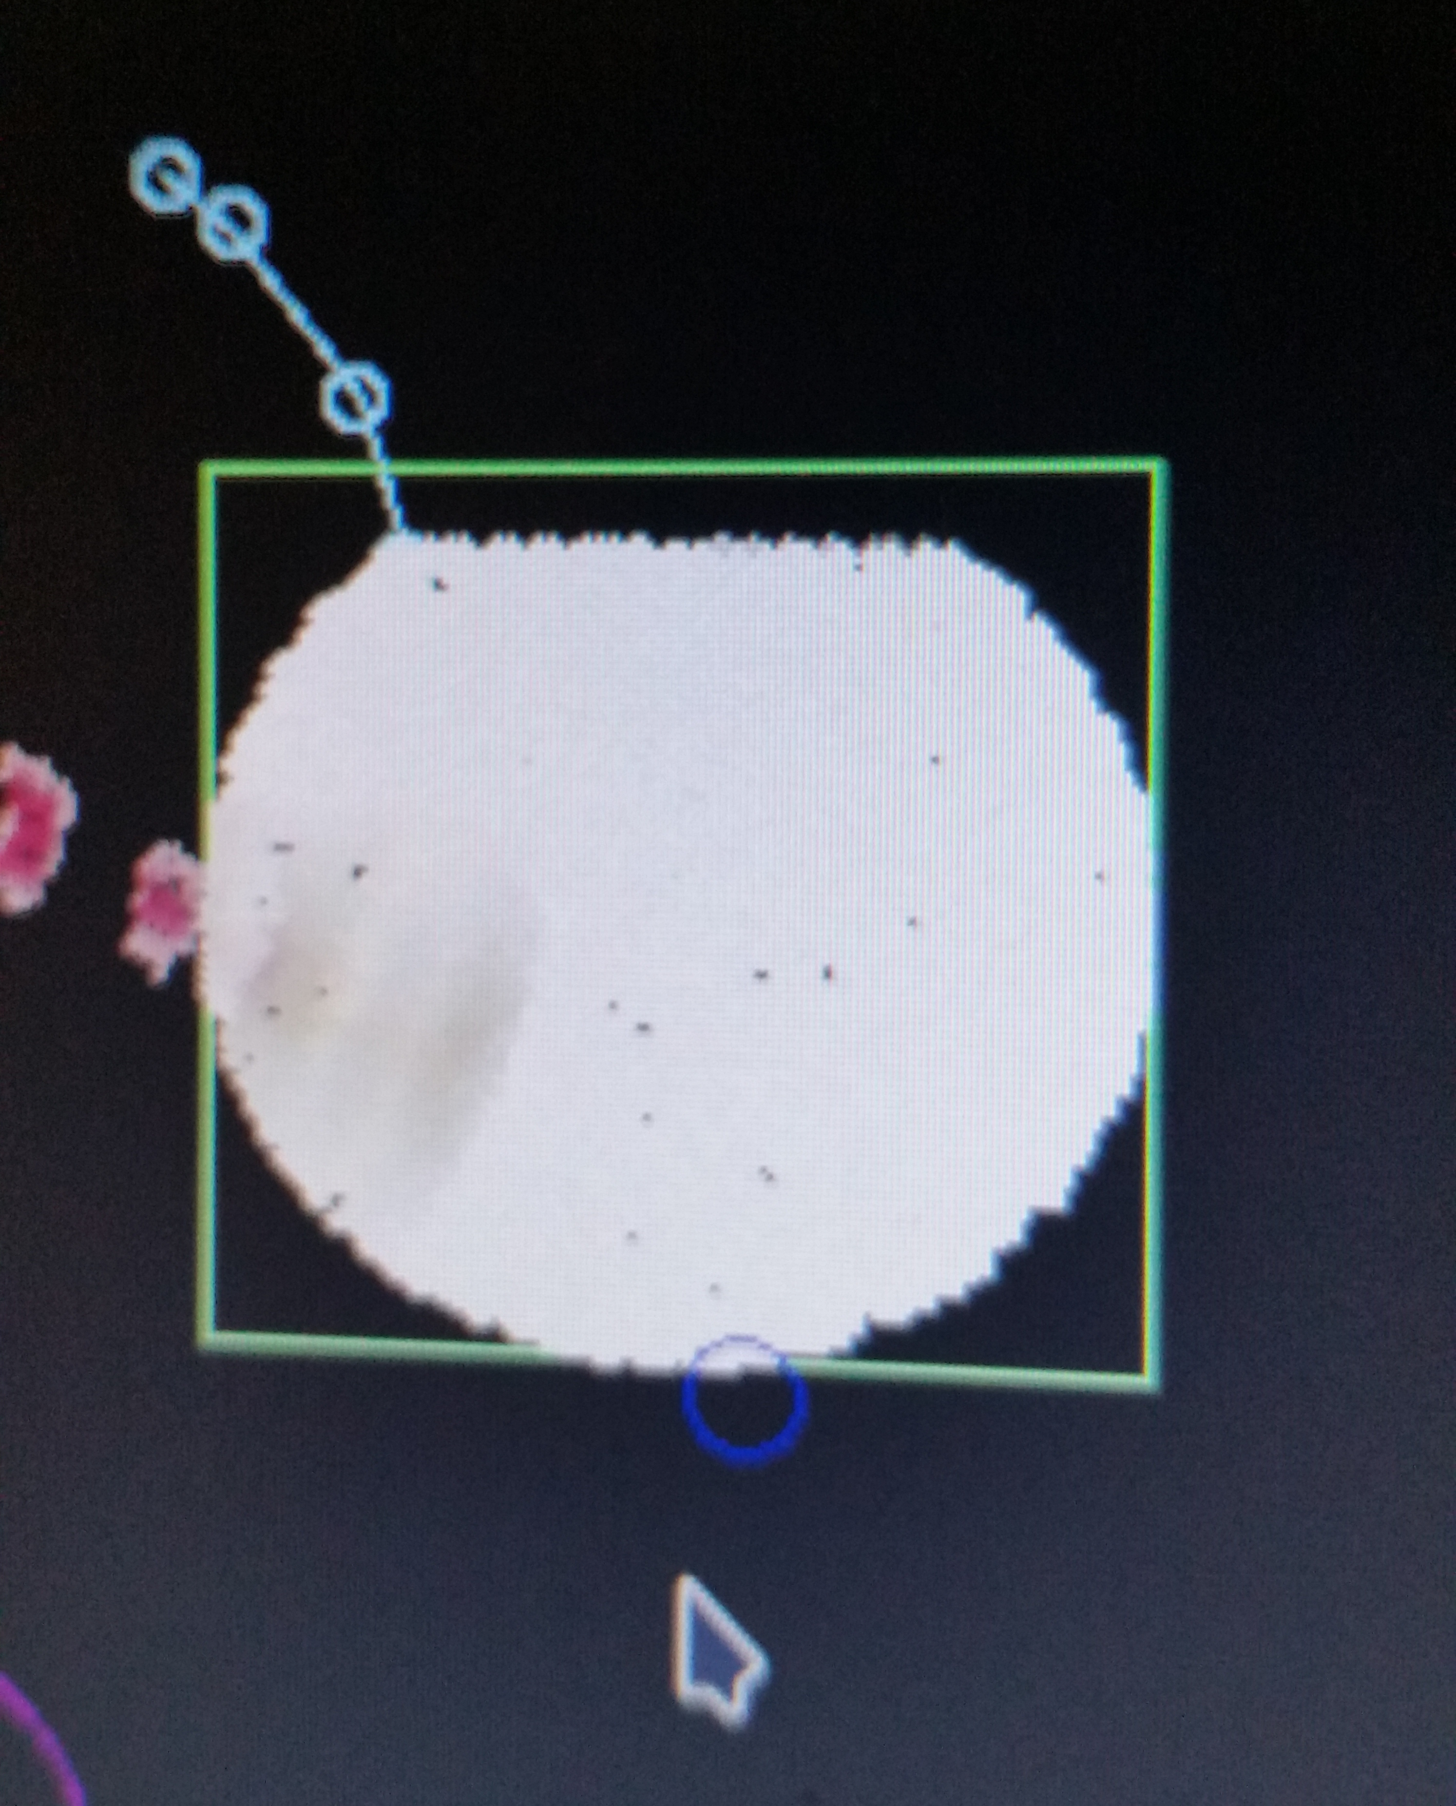
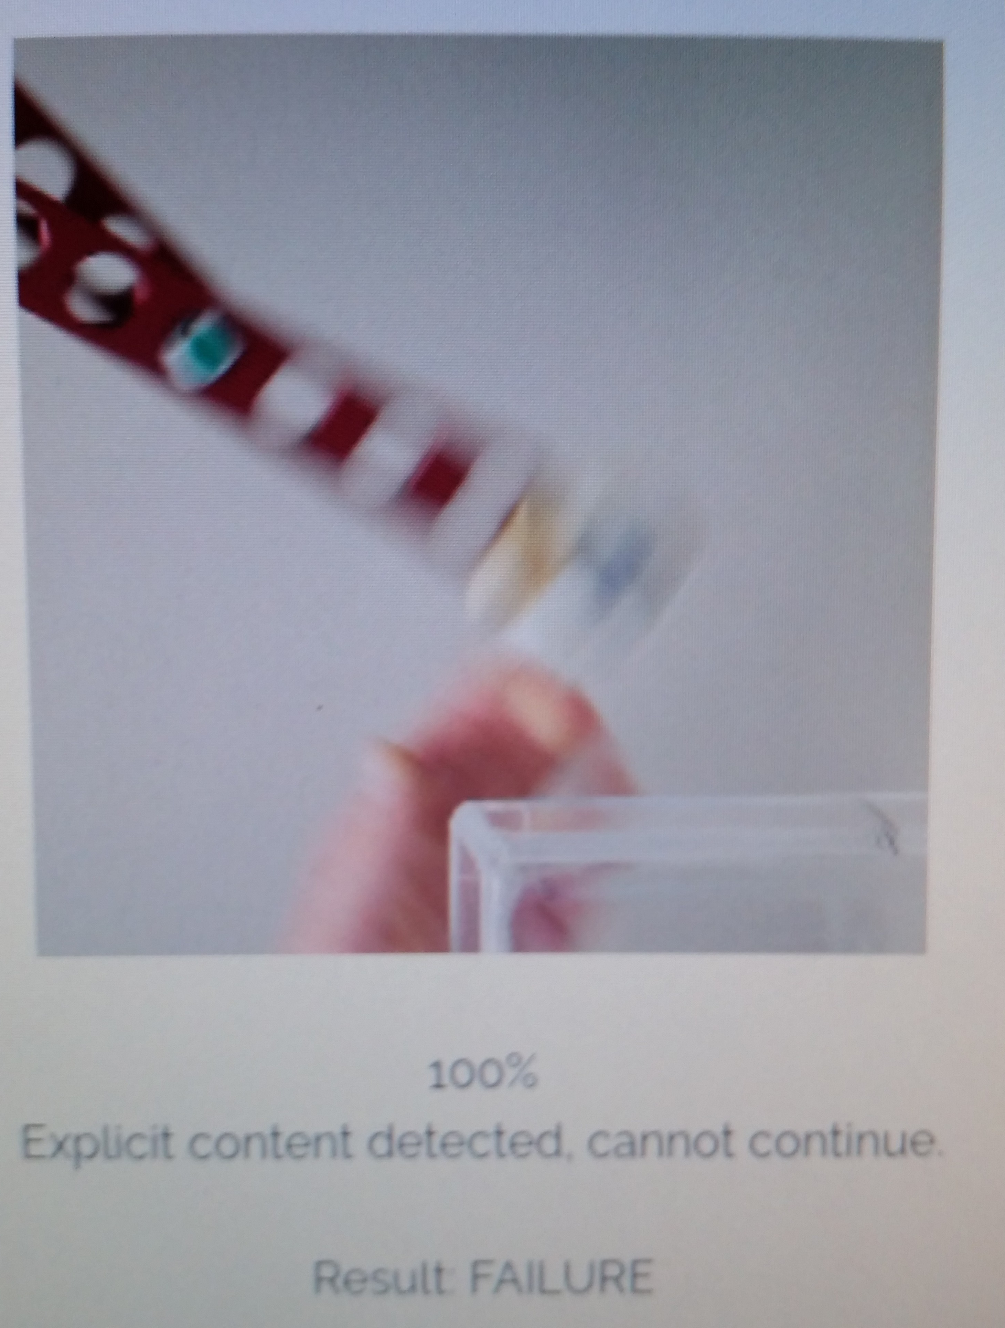
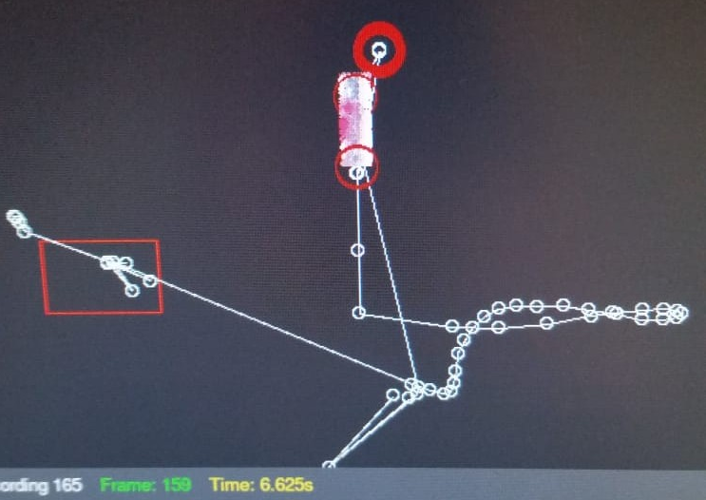
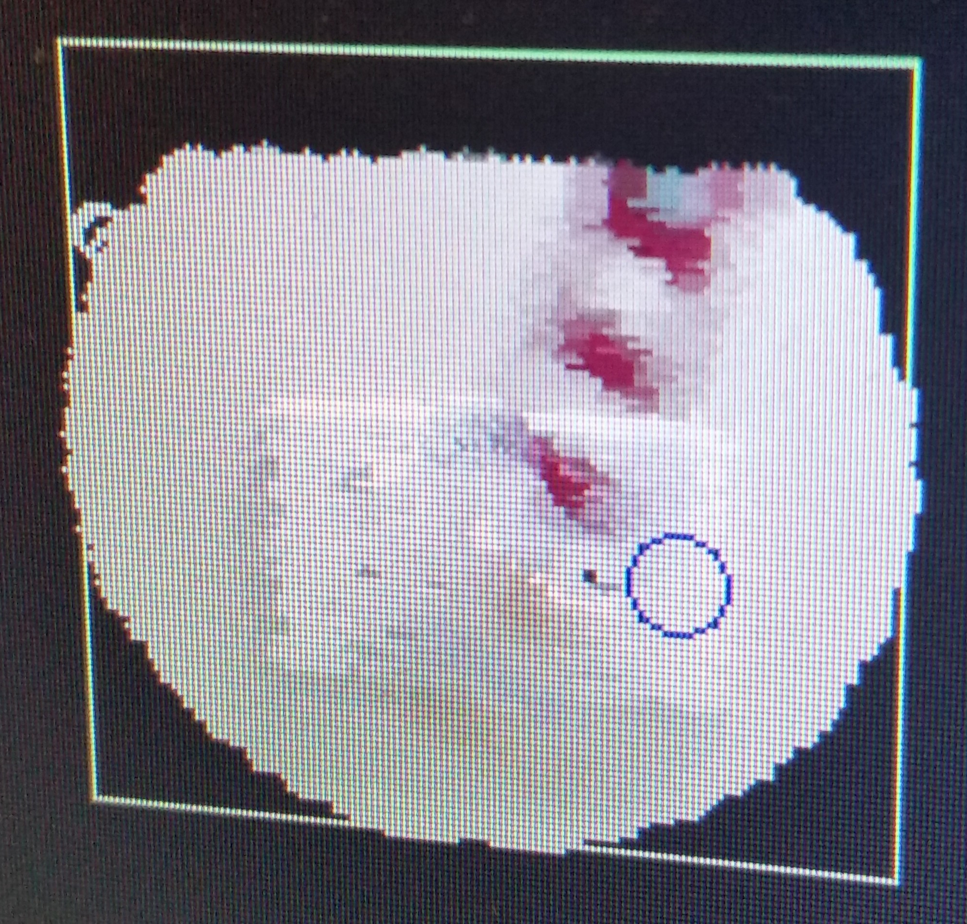
Tracking the Nodes
Dealing with Motion Blur
Can you see any blue in there? I can’t see any blue in there.
Low angle tracking was possible at 24 FPS.
Background objects made things difficult.
Hard to track fast motions.
Online blur removers refused to help.
Notes:
Murray

Slide 6

Tracking the Nodes
Retake of data at 120 FPS.
No more blur!
Tracking worked easily using OpenCV + Python.
Notes:
Murray

Slide 7
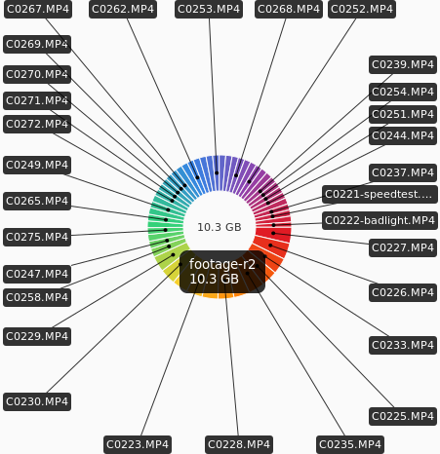
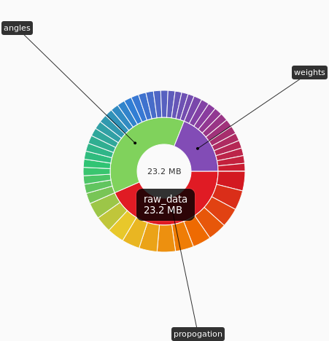
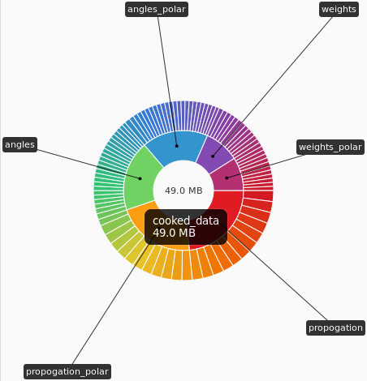

Cleaning the data
Node tracking.
Rationalise coordinate system +
Interpolation.
Collation + Time correction.
Notes:
Speaker: Riley J

Slide 8
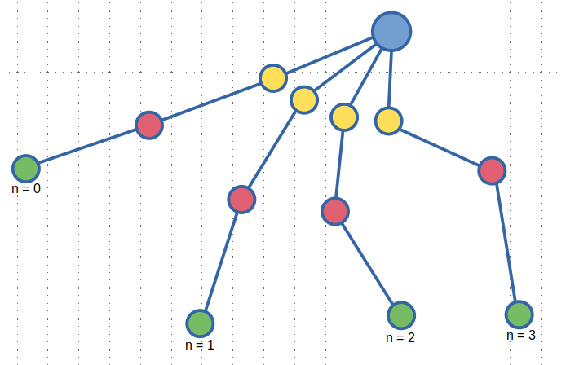
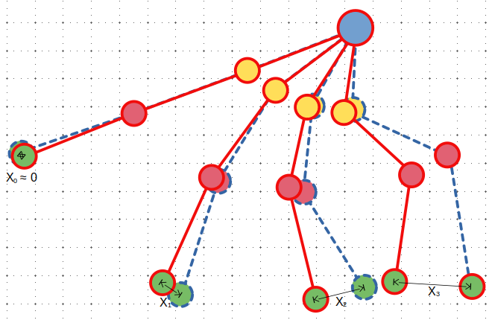
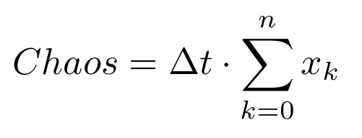

Analysing the Data
Quantifying Chaos
Total number of frames.
Time between each frame.
Distance between end node positions for this frame on different runs with same initial conditions.
Index of current frame.
Notes:
Murray

Slide 9
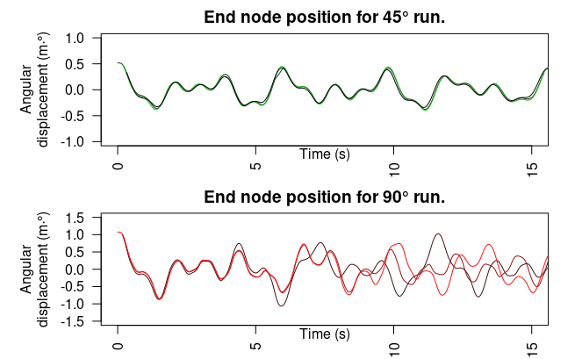
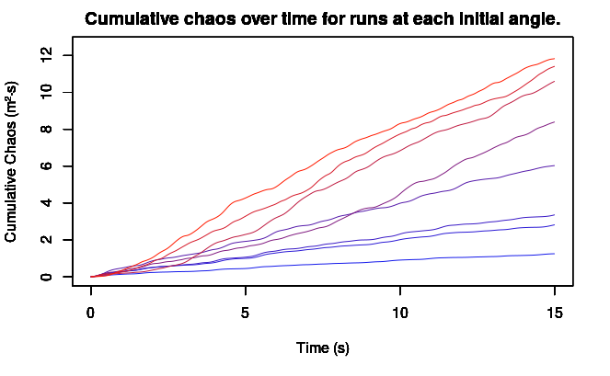
Preliminary Results
Chaotic motion becomes evident.
Notes:
Murray

Slide 10
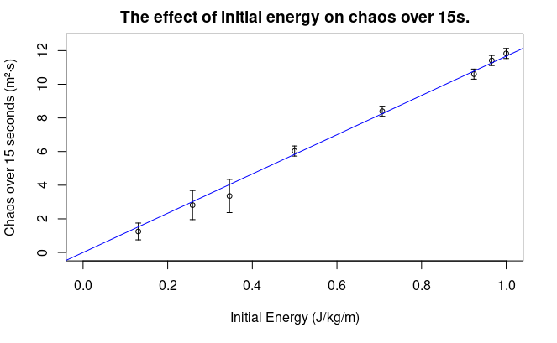
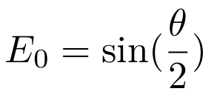
Final Results
R² = 0.998
P Value = 3.03·10⁻¹¹
E0 = 0 at 0°, minimum.
E0 = 1 at 180°, maximum.
Notes:
Murray

Slide 11
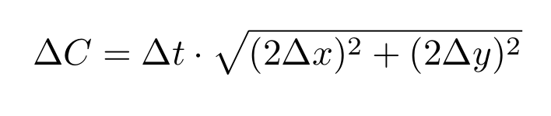
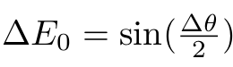
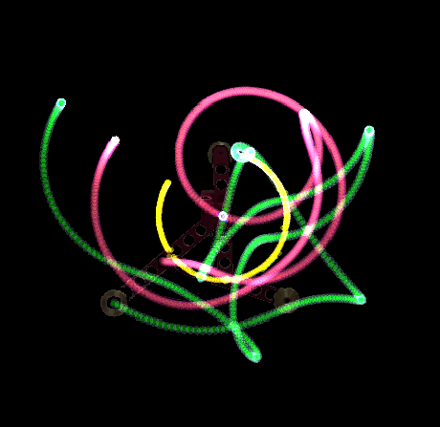
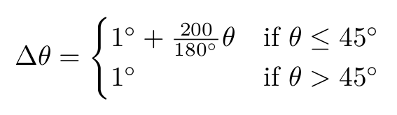
Uncertainties
Uncertainty in quantity of chaos.
Uncertainty in initial energy
Uncertainty in duration of footage ≈̠ 0.008s.
Uncertainty in node coordinates ≪ 1px. (3,4)
Uncertainty in initial angle.
Uncertainty due to protractor with weird scale (above).
Initial angle.
Standard uncertainty in protractor measurement.
Notes:
Speaker: Yunki
These were the methods that we used to propagate uncertainties – The uncertainty in chaos is associated with the uncertainty in time and the position coordinates, which were relative to the frame rate of the recording and the coordinate system used in the software, both of which was considered reasonably negligible for the resolution purposes of this analysis.
The way this analysis relatively quantified the initial energy was from the angle which is associated with the uncertainties of using an analogue protractor which by convention is usually half the smallest marking. The protractor seemed to have a strange scale on it where 200 was equal to 180 degrees, so we did do some measurements using the incorrect scale which we then had to back-calculate and this error was factored into the uncertainty calculation.

Slide 12
Conclusion & Questions
Notes:
Murray

Slide 13
References
1. Levien RB, Tan SM. Double pendulum: An experiment in chaos. American Journal of Physics. 1993;61(11):1038-44.
2. Litak G, Borowiec M, Da̧bek K. The Transition to Chaos of Pendulum Systems. Applied Sciences. 2022;12(17):8876.
3. Lückemann P, Forrester S, Mears A, Shepherd J, Roberts J. Assessment of Measurement Uncertainty in Optical Marker Tracking of High-Speed Motion. Proceedings. 2020;49(1):72.
4. Skurowski P, Pawlyta M. On the Noise Complexity in an Optical Motion Capture Facility. Sensors (Basel). 2019;19(20).

